Slide 1
Context
This slide deck aims to focus all energy on identifying the location and name of items by reducing the fatigue of searching for numbers and by maintaining a consistent focus and zoom on items being studied.
The items are from the OCT 2024 MC-6 Nomenclature PDF.
For additional resources and guides see:
https://irregularpedia.org/index.php/Jump_Master_(Training)
Return to Main

Slide 2
Main Menu
MAW-C
Snap Shackle
Slide Fastener and Tabbed Thong
Hook Pile Tape Lowering Line
Harness Single Point Release
Advance Combat Helmet
Universal Static Line Modified
Canopy Release Assembly
Main Lift Web
Pack Tray (Zoom)
Reserve Pack Tray
MC-6 Riser Assembly
Return to Main

Slide 3
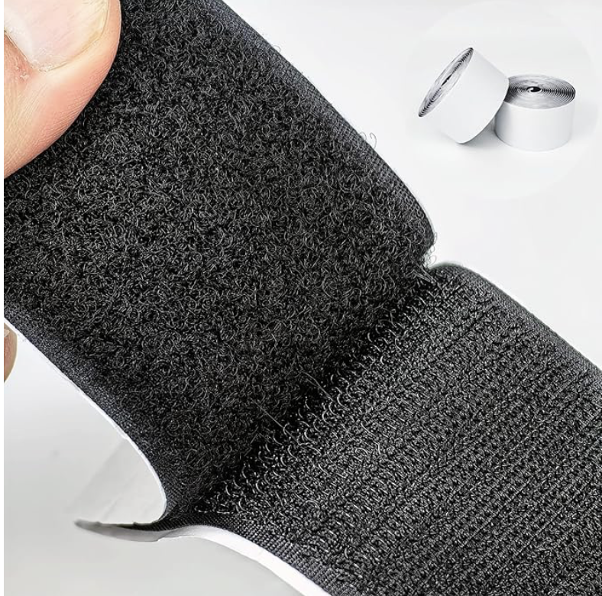
1
2
Common Terms
Return to Main

Slide 4
Hook(1) Pile(2) Tape
1
2
Common Terms
Return to Main

Slide 5
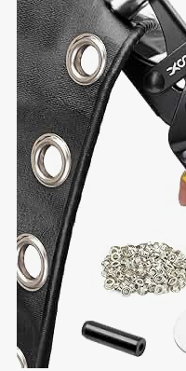
Common Terms
Return to Main

Slide 6
Grommets
Common Terms
Return to Main

Slide 7
Common Terms
Return to Main

Slide 8
Snap Fastener
Common Terms
Return to Main

Slide 9
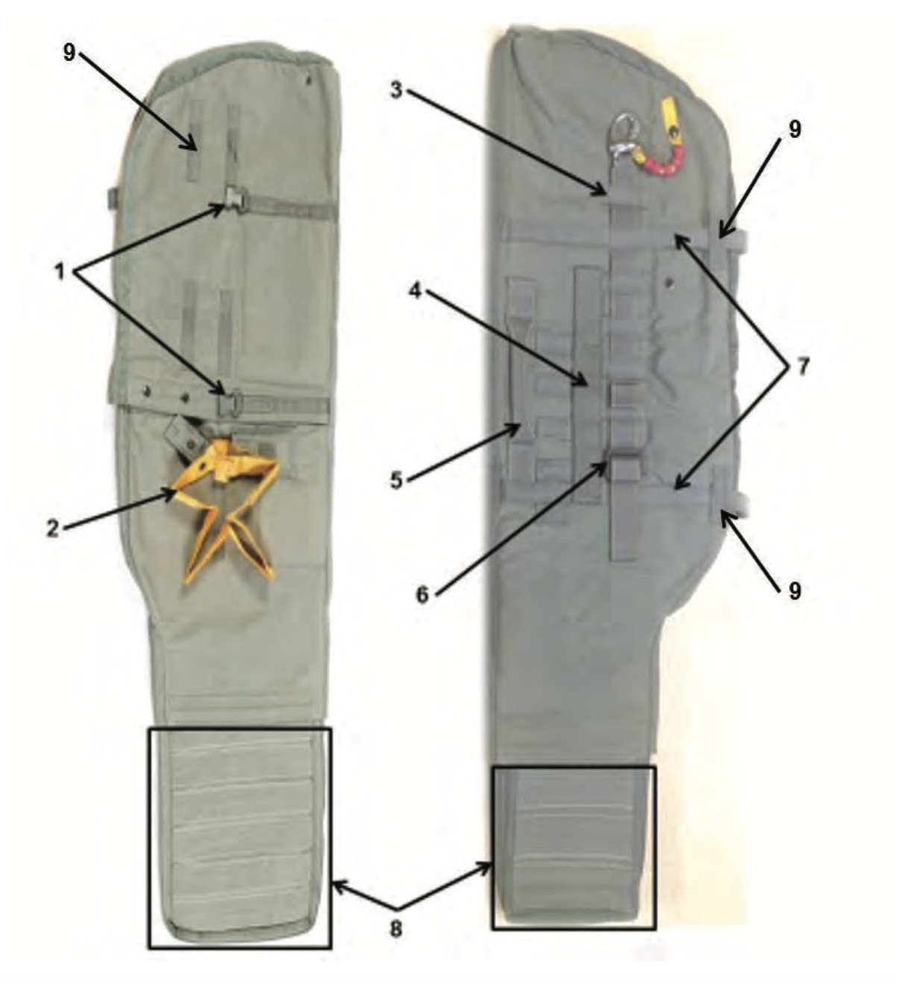
MAW-C nomenclature
Return to Main

Slide 10
MAW-C 1
Return to Main

Slide 11
Quick Release Buckle
MAW-C 1
Return to Main

Slide 12
MAW-C 2
Return to Main

Slide 13
Lower Tie Down Strap
MAW-C 2
Return to Main

Slide 14
MAW-C 3
Return to Main

Slide 15
Pouch Attachment Ladder System Webbing
MAW-C 3
Return to Main

Slide 16
MAW-C 4
Return to Main

Slide 17
Attachment Strap
MAW-C 4
Return to Main

Slide 18
MAW-C 5
Return to Main

Slide 19
Carrying Handle
MAW-C 5
Return to Main

Slide 20
MAW-C 6
Return to Main

Slide 21
Friction Adapter
MAW-C 6
Return to Main

Slide 22
MAW-C 7
Return to Main

Slide 23
Compression Strap
MAW-C 7
Return to Main

Slide 24
MAW-C 8
Return to Main

Slide 25
Adjustable Nose Cone
MAW-C 8
Return to Main

Slide 26
MAW-C 9
Return to Main

Slide 27
Verticle Nylon Equipment Hanger
9
Return to Main

Slide 28
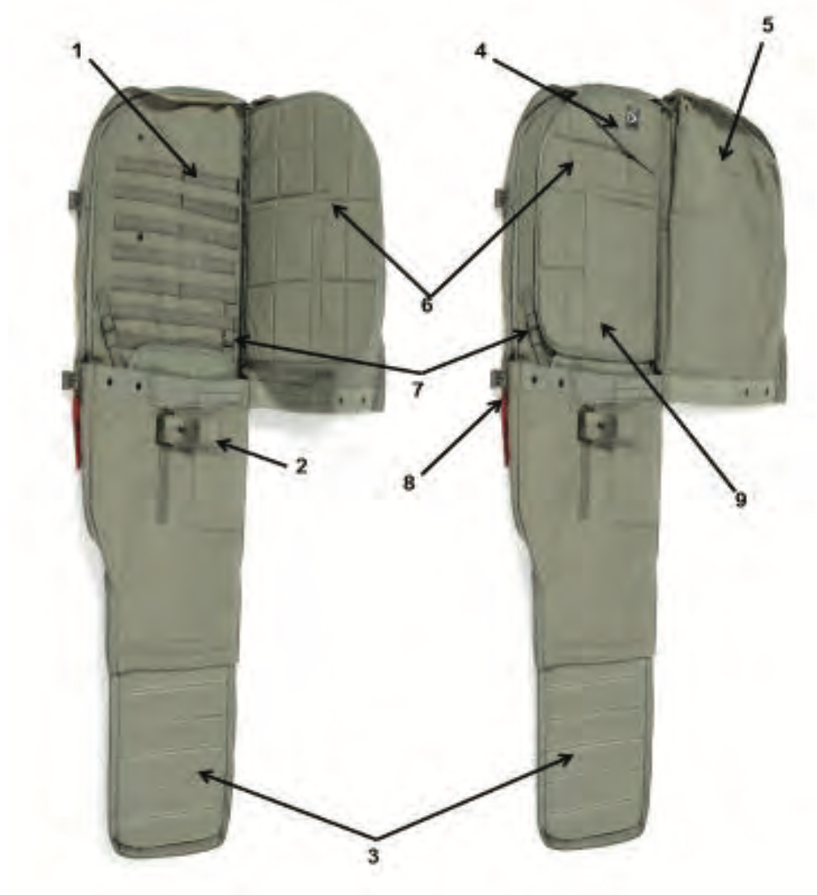
MAL-C (opened) nomenclature
Return to Main

Slide 29
MAL-C (opened) 1
Return to Main

Slide 30
Pouch Attachment Ladder System Webbing
MAL-C (opened) 1
Return to Main

Slide 31
MAL-C (opened) 2
Return to Main

Slide 32
Lower Tiedown Strap Stow Pocket
MAL-C (opened) 2
Return to Main

Slide 33
MAL-C (opened) 3
Return to Main

Slide 34
Pile Tape
MAL-C (opened) 3
Return to Main

Slide 35
MAL-C (opened) 4
Return to Main

Slide 36
Rifle Butt Stow Pocket
MAL-C (opened) 4
Return to Main

Slide 37
MAL-C (opened) 5
Return to Main

Slide 38
Closing Flap
MAL-C (opened) 5
Return to Main

Slide 39
MAL-C (opened) 6
Return to Main

Slide 40
Internal Padded Divider
MAL-C (opened) 6
Return to Main

Slide 41
MAL-C (opened) 7
Return to Main

Slide 42
Nose Cone Securing Strap
MAL-C (opened) 7
Return to Main

Slide 43
MAL-C (opened) 8
Return to Main

Slide 44
Slide Fastener and Tabbed Thong
MAL-C (opened) 8
Return to Main

Slide 45
MAL-C (opened) 9
Return to Main

Slide 46
Internal Pocket
MAL-C (opened) 9
Return to Main

Slide 47
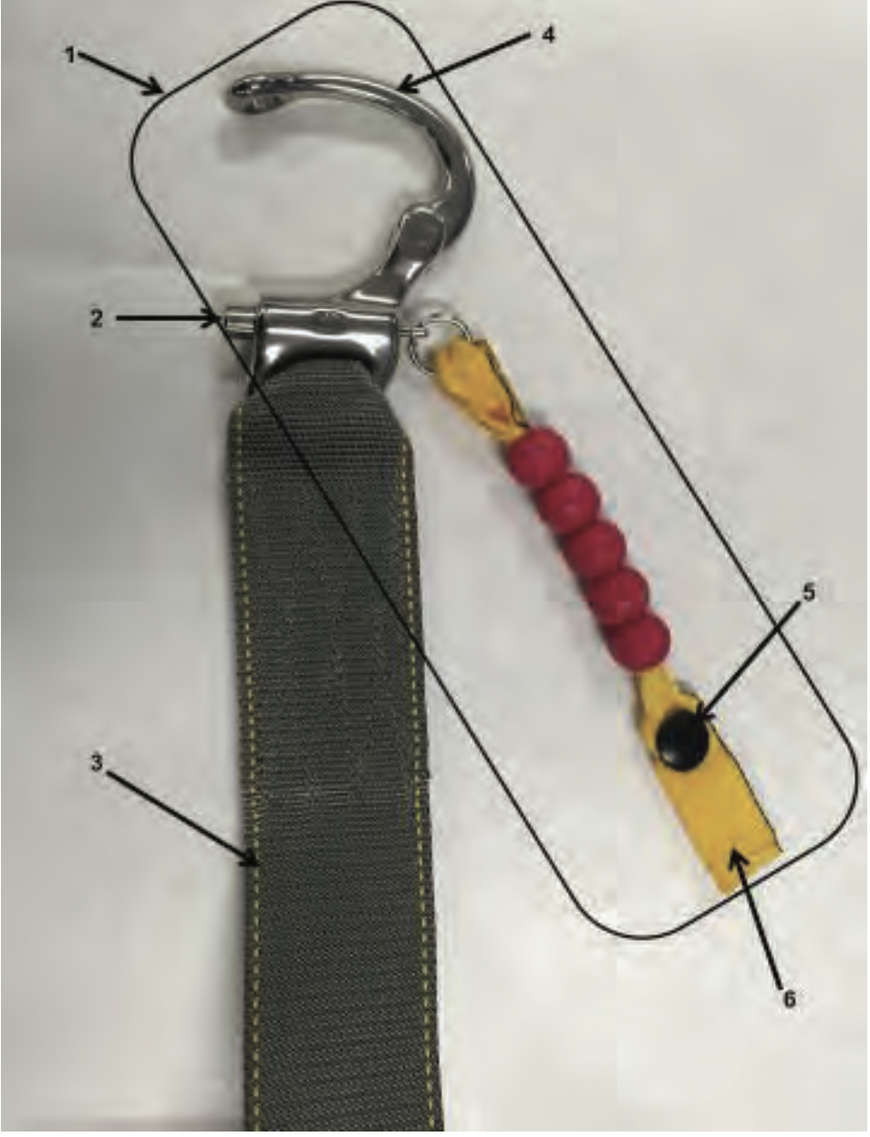
SNAP SHACKLE
Return to Main

Slide 48
SNAP SHACKLE - 1
Return to Main

Slide 49
Snap Shackle with Yellow Safety Lanyard
SNAP SHACKLE - 1
Return to Main

Slide 50
SNAP SHACKLE - 2
Return to Main

Slide 51
Locking Pin
SNAP SHACKLE - 2
Return to Main

Slide 52
SNAP SHACKLE -3
Return to Main

Slide 53
Adjusting Strap
SNAP SHACKLE -3
Return to Main

Slide 54
SNAP SHACKLE -4
Return to Main

Slide 55
Opening Gate
SNAP SHACKLE -4
Return to Main

Slide 56
SNAP SHACKLE -5
Return to Main

Slide 57
Snap Fastener
SNAP SHACKLE -5
Return to Main

Slide 58
SNAP SHACKLE - 6
Return to Main

Slide 59
Yellow Safety Lanyard
SNAP SHACKLE - 6
Return to Main

Slide 60
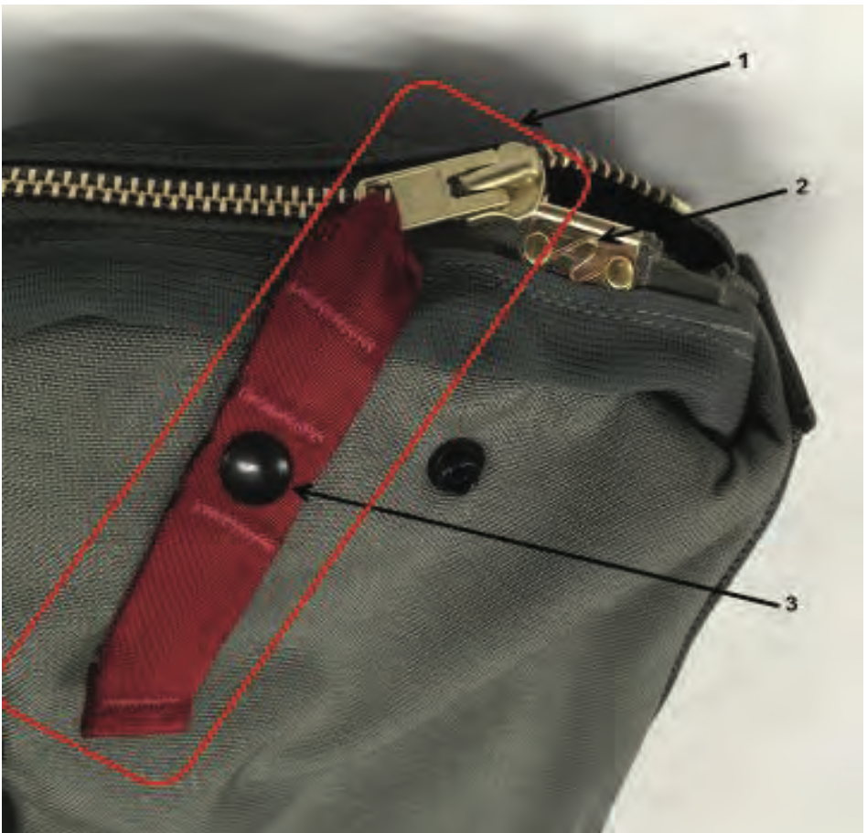
SLIDE FASTENER AND
TABBED THONG
Return to Main

Slide 61
SLIDE FASTENER AND TABBED THONG - 1
Return to Main

Slide 62
Slide Fastener and Tabbed Thong
SLIDE FASTENER AND TABBED THONG - 1
Return to Main

Slide 63
SLIDE FASTENER AND TABBED THONG - 2
Return to Main

Slide 64
Upper Spring Stop
SLIDE FASTENER AND TABBED THONG - 2
Return to Main

Slide 65
SLIDE FASTENER AND TABBED THONG - 3
Return to Main

Slide 66
Snap Fastener
SLIDE FASTENER AND TABBED THONG - 3
Return to Main

Slide 67
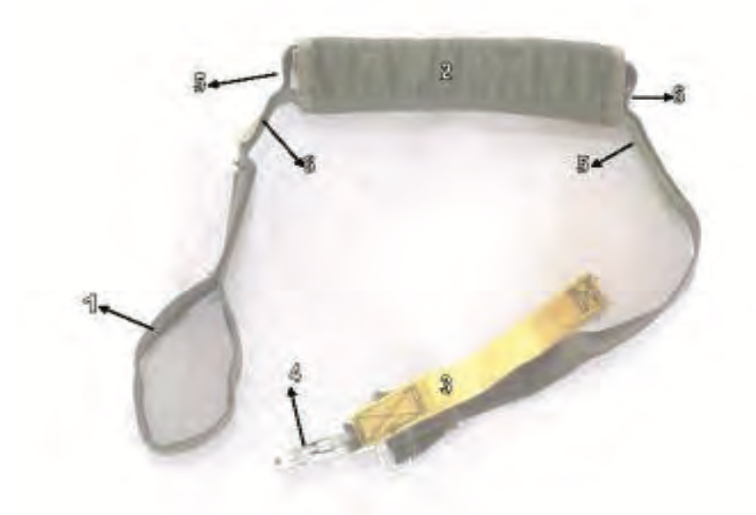
HOOK PILE TAPE LOWERING LINE
Return to Main

Slide 68
HOOK PILE TAPE LOWERING LINE - 1
Return to Main

Slide 69
Looped End Hook Pile Tape Lowering Line
HOOK PILE TAPE LOWERING LINE - 1
Return to Main

Slide 70
HOOK PILE TAPE LOWERING LINE - 2
Return to Main

Slide 71
Retainer Flap
HOOK PILE TAPE LOWERING LINE - 2
Return to Main

Slide 72
HOOK PILE TAPE LOWERING LINE - 3
Return to Main

Slide 73
Yellow Safety Lanyard
HOOK PILE TAPE LOWERING LINE - 3
Return to Main

Slide 74
HOOK PILE TAPE LOWERING LINE - 4
Return to Main

Slide 75
Ejector Snap
HOOK PILE TAPE LOWERING LINE - 4
Return to Main

Slide 76
HOOK PILE TAPE LOWERING LINE - 5
Return to Main

Slide 77
Hook Tab
HOOK PILE TAPE LOWERING LINE - 5
Return to Main

Slide 78
HOOK PILE TAPE LOWERING LINE - 6
Return to Main

Slide 79
Pile Tab
HOOK PILE TAPE LOWERING LINE - 6
Return to Main

Slide 80
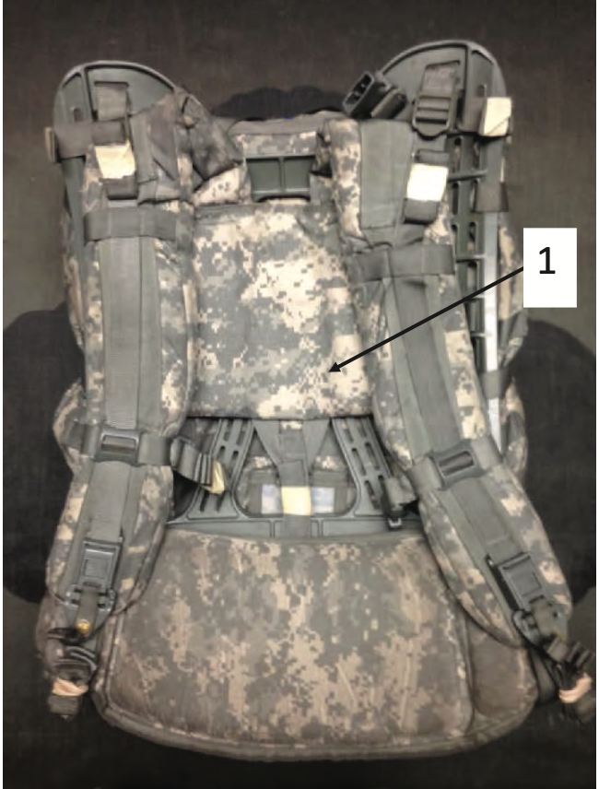
MODULAR LIGHTWEIGHT LOAD-
CARRYING EQUIPMENT (MOLLE)
Return to Main

Slide 81
Return to Main
MODULAR LIGHTWEIGHT LOAD- CARRYING EQUIPMENT (MOLLE) - 1

Slide 82
Adjustable Shoulder Carrying Strap
Return to Main
MODULAR LIGHTWEIGHT LOAD- CARRYING EQUIPMENT (MOLLE) - 1

Slide 83
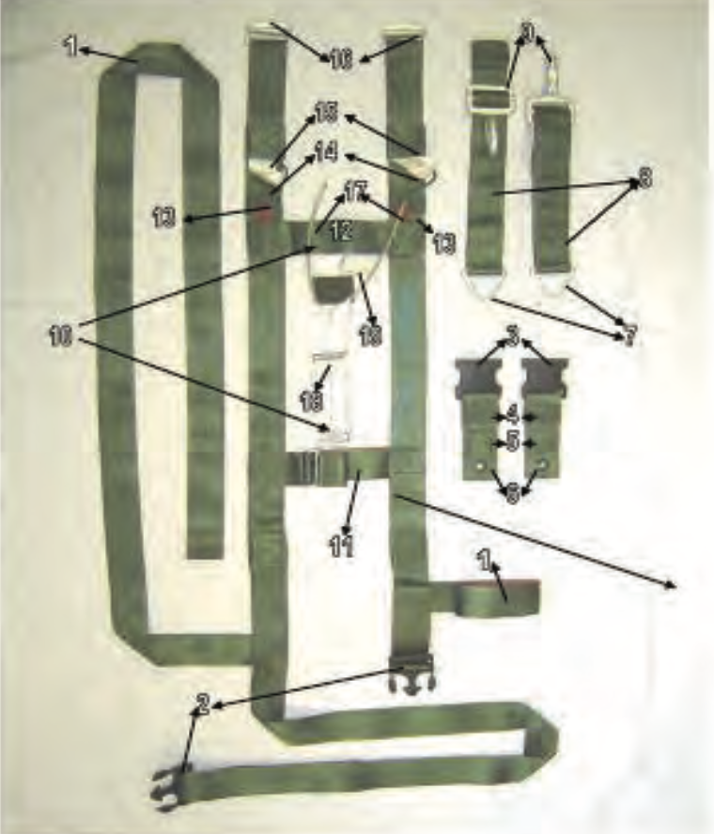
Harness Single Point Release
Return to Main

Slide 84
Harness Single Point Release - 1
Return to Main

Slide 85
Equipment Retainer Strap
Harness Single Point Release - 1
Return to Main

Slide 86
Harness Single Point Release - 2
Return to Main

Slide 87
Male Portion, Ejector Strap Release Assembly
Harness Single Point Release - 2
Return to Main

Slide 88
Harness Single Point Release - 3
Return to Main

Slide 89
Female Portion, Ejector Strap Release Assembly
Harness Single Point Release - 3
Return to Main

Slide 90
Harness Single Point Release - 4
Return to Main

Slide 91
Webbing Retainer
Harness Single Point Release - 4

Slide 92
Harness Single Point Release - 5
Return to Main

Slide 93
Cable Loop Retainer
Harness Single Point Release - 5
Return to Main

Slide 94
Harness Single Point Release - 6
Return to Main

Slide 95
Grommet
Harness Single Point Release - 6
Return to Main

Slide 96
`
Harness Single Point Release - 7
Return to Main

Slide 97
Triangle Link
Harness Single Point Release - 7
Return to Main

Slide 98
Harness Single Point Release - 8
Return to Main

Slide 99
Adjustable D Ring Adjusting Strap
Harness Single Point Release - 8
Return to Main

Slide 100
Harness Single Point Release - 9
Return to Main

Slide 101
Snap Hook
Harness Single Point Release - 9
Return to Main

Slide 102
Harness Single Point Release - 10
Return to Main

Slide 103
Release Handle Assembly
Harness Single Point Release - 10
Return to Main

Slide 104
Harness Single Point Release - 11
Return to Main

Slide 105
Adjustable Cross Strap
Harness Single Point Release - 11
Return to Main

Slide 106
Harness Single Point Release - 12
Return to Main

Slide 107
Release Handle Cross Strap
Harness Single Point Release - 12
Return to Main

Slide 108
Harness Single Point Release - 13
Return to Main

Slide 109
Red Attaching Loop
Harness Single Point Release - 13
Return to Main

Slide 110
Harness Single Point Release - 14
Return to Main

Slide 111
Green Attaching Loop
Harness Single Point Release - 14
Return to Main

Slide 112
Harness Single Point Release - 15
Return to Main

Slide 113
White Attaching Loop
Harness Single Point Release - 15
Return to Main

Slide 114
Harness Single Point Release - 16
Return to Main

Slide 115
Friction Adapter
Harness Single Point Release - 16
Return to Main

Slide 116
Harness Single Point Release - 17
Return to Main

Slide 117
Release Handle Cable
Harness Single Point Release - 17
Return to Main

Slide 118
Harness Single Point Release - 18
Return to Main

Slide 119
Release Handle Lanyard
Harness Single Point Release - 18
Return to Main

Slide 120
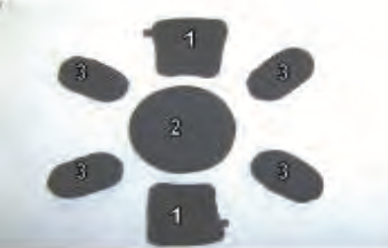
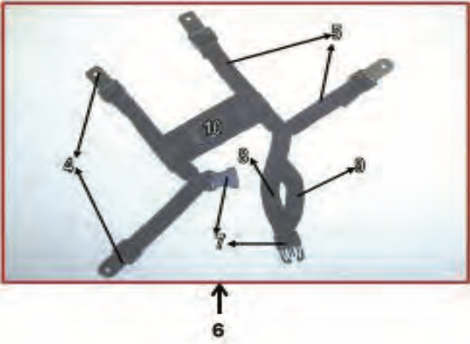
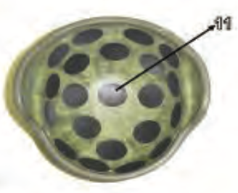
Advanced Combat Helmet (ACH)
Return to Main

Slide 121
Advanced Combat Helmet - 1
Return to Main

Slide 122
Trapezoid Pad
Advanced Combat Helmet - 1
Return to Main

Slide 123
Advanced Combat Helmet - 2
Return to Main

Slide 124
Crown Pad
Advanced Combat Helmet - 2
Return to Main

Slide 125
Advanced Combat Helmet - 3
Return to Main

Slide 126
Oval Pad
Advanced Combat Helmet - 3
Return to Main

Slide 127
Advanced Combat Helmet - 4
Return to Main

Slide 128
Adjustable Buckle
Advanced Combat Helmet - 4
Return to Main

Slide 129
Advanced Combat Helmet - 5
Return to Main

Slide 130
Adjustable Strap
Advanced Combat Helmet - 5
Return to Main

Slide 131
Advanced Combat Helmet - 6
Return to Main

Slide 132
Modified Chin Strap Assembly
Advanced Combat Helmet - 6
Return to Main

Slide 133
Advanced Combat Helmet - 7
Return to Main

Slide 134
Chin Strap Fastener
Advanced Combat Helmet - 7
Return to Main

Slide 135
Advanced Combat Helmet - 8
Return to Main

Slide 136
Long Portion Chin Strap
Advanced Combat Helmet - 8
Return to Main

Slide 137
Advanced Combat Helmet - 9
Return to Main

Slide 138
Short Portion Chin Strap
Advanced Combat Helmet - 9
Return to Main

Slide 139
Advanced Combat Helmet - 10
Return to Main

Slide 140
Nape Pad
Advanced Combat Helmet - 10
Return to Main

Slide 141
Advanced Combat Helmet - 11
Return to Main

Slide 142
Hook Disk
Advanced Combat Helmet - 11
Return to Main

Slide 143
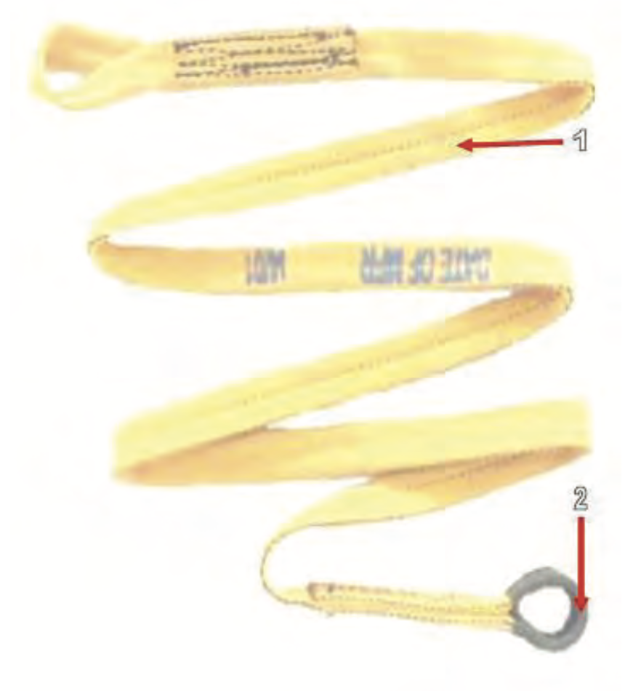
5 FOOT UNIVERSAL
STATIC LINE
EXTENSION
Return to Main

Slide 144
5 FOOT UNIVERSAL STATIC LINE EXTENSION - 1
Return to Main

Slide 145
5 FOOT UNIVERSAL STATIC LINE EXTENSION
5 FOOT UNIVERSAL STATIC LINE EXTENSION - 1
Return to Main

Slide 146
5 FOOT UNIVERSAL STATIC LINE EXTENSION - 2
Return to Main

Slide 147
Cotton Buffer
5 FOOT UNIVERSAL STATIC LINE EXTENSION - 2
Return to Main

Slide 148
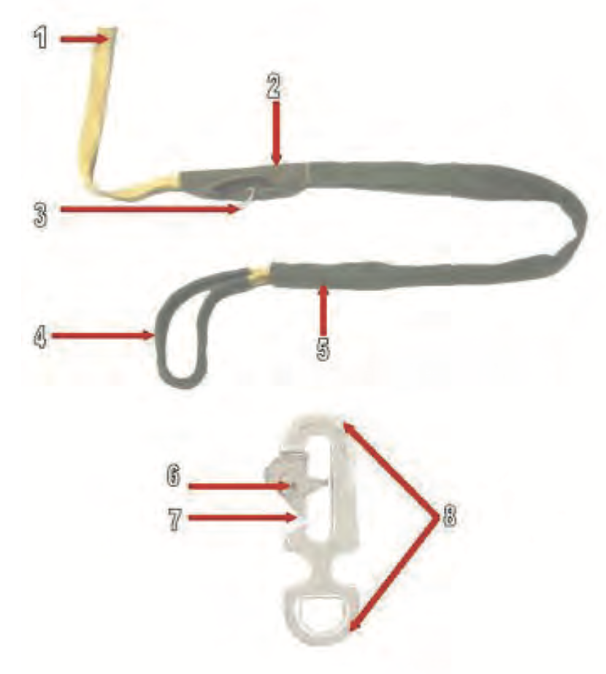
Universal Static Line Modified
Return to Main

Slide 149
Universal Static Line Modified - 1
Return to Main

Slide 150
Universal Static Line Modified
Universal Static Line Modified - 1
Return to Main

Slide 151
Universal Static Line Modified - 2
Return to Main

Slide 152
Main Curved Pin Cover
Universal Static Line Modified - 2
Return to Main

Slide 153
Universal Static Line Modified - 3
Return to Main

Slide 154
Main Curved Pin
Universal Static Line Modified - 3
Return to Main

Slide 155
Universal Static Line Modified - 4
Return to Main

Slide 156
Cotton Buffer
Universal Static Line Modified - 4
Return to Main

Slide 157
Universal Static Line Modified - 5
Return to Main

Slide 158
Static Line Sleeve
Universal Static Line Modified - 5
Return to Main

Slide 159
Universal Static Line Modified - 6
Return to Main

Slide 160
Rivet Pin
Universal Static Line Modified - 6
Return to Main

Slide 161
Universal Static Line Modified - 7
Return to Main

Slide 162
Spring Opening Gate
Universal Static Line Modified - 7
Return to Main

Slide 163
Universal Static Line Modified - 8
Return to Main

Slide 164
Universal Static Line Snap Hook
Universal Static Line Modified - 8
Return to Main

Slide 165
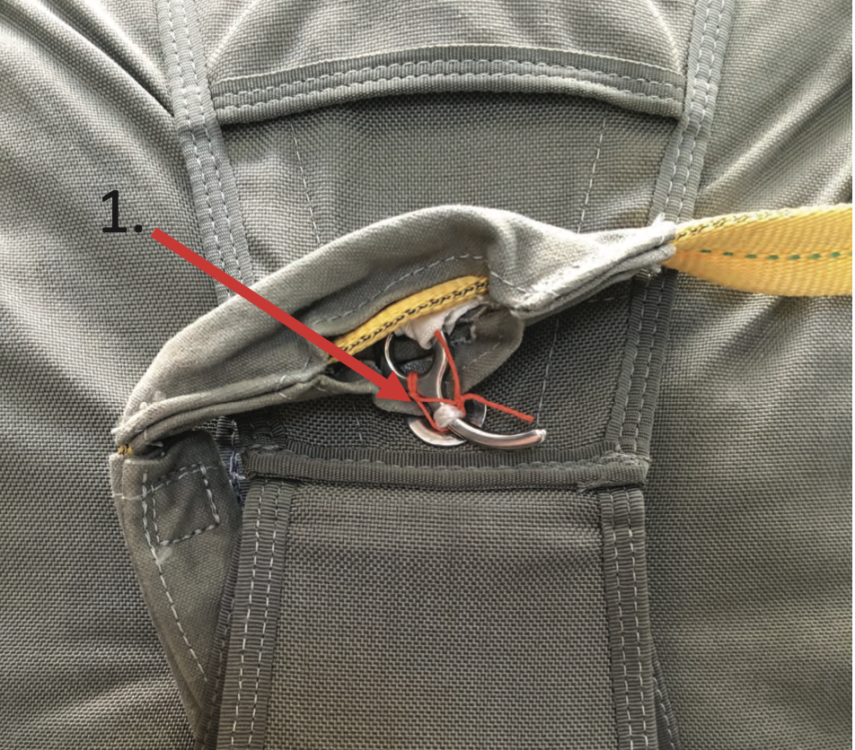
MAIN CURVED PIN SECURING
TIE
Return to Main

Slide 166
MAIN CURVED PIN SECURING TIE - 1
Return to Main

Slide 167
Main curved pin securing tie (must be orange and constructed of type 8/4
cotton thread)
MAIN CURVED PIN SECURING TIE - 1
Return to Main

Slide 168
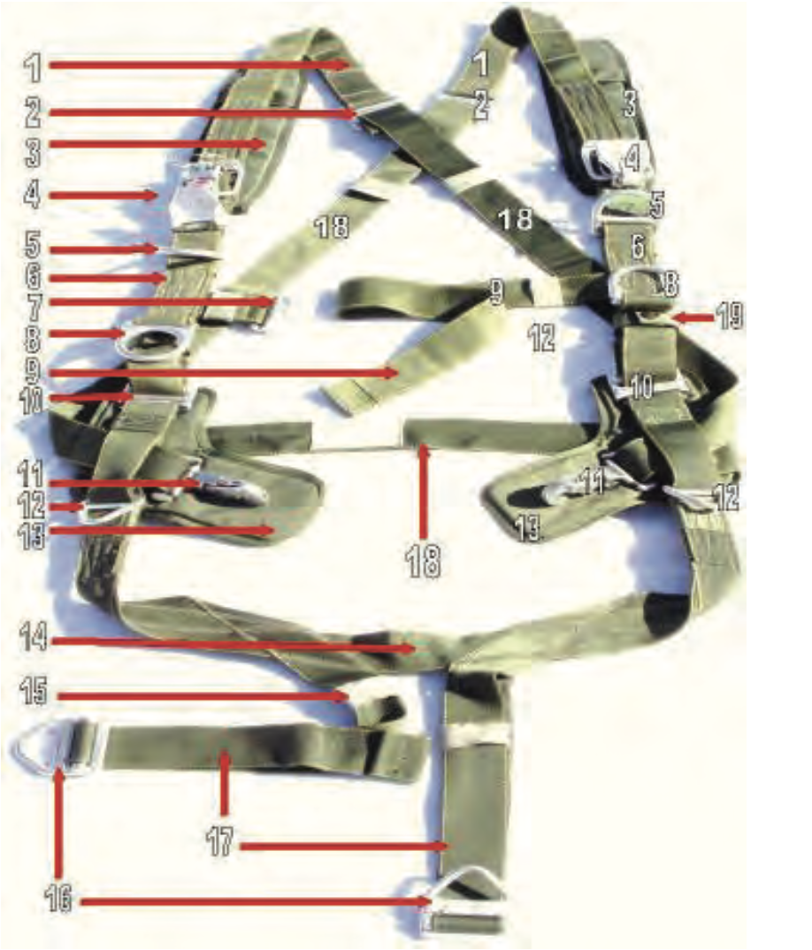
Harness Assembly
Return to Main

Slide 169
Harness Assembly - 1
Return to Main

Slide 170
Diagonal Backstrap
Harness Assembly - 1
Return to Main

Slide 171
Harness Assembly - 2
Return to Main

Slide 172
Backstrap Adjuster
Harness Assembly - 2
Return to Main

Slide 173
Harness Assembly - 3
Return to Main

Slide 174
Diagonal Backstrap Pad
Harness Assembly - 3
Return to Main

Slide 175
Harness Assembly - 4
Return to Main

Slide 176
Canopy Release Assembly
Harness Assembly - 4
Return to Main

Slide 177
Harness Assembly - 5
Return to Main

Slide 178
D Ring
Harness Assembly - 5
Return to Main

Slide 179
Harness Assembly - 6
Return to Main

Slide 180
Main Lift Web
Harness Assembly - 6
Return to Main

Slide 181
Harness Assembly - 7
Return to Main

Slide 182
Chest Strap Friction Adapter
Harness Assembly - 7
Return to Main

Slide 183
Harness Assembly - 8
Return to Main

Slide 184
Equipment Ring
Harness Assembly - 8
Return to Main

Slide 185
Harness Assembly - 9
Return to Main

Slide 186
Chest Strap
Harness Assembly - 9
Return to Main

Slide 187
Harness Assembly - 10
Return to Main

Slide 188
Main Lift Web Adjuster
Harness Assembly - 10
Return to Main

Slide 189
Harness Assembly - 11
Return to Main

Slide 190
Ejector Snap
Harness Assembly - 11
Return to Main

Slide 191
Harness Assembly - 12
Return to Main

Slide 192
Triangle Link
Harness Assembly - 12
Return to Main

Slide 193
Harness Assembly - 13
Return to Main

Slide 194
L Shaped Ejector Snap Pad
Harness Assembly - 13
Return to Main

Slide 195
Harness Assembly - 14
Return to Main

Slide 196
Saddle
Harness Assembly - 14
Return to Main

Slide 197
Harness Assembly - 15
Return to Main

Slide 198
Webbing Retainer
Harness Assembly - 15
Return to Main

Slide 199
Harness Assembly - 16
Return to Main

Slide 200
Quick Fit V Ring
Harness Assembly - 16
Return to Main

Slide 201
Harness Assembly - 17
Return to Main

Slide 202
Leg Strap
Harness Assembly - 17
Return to Main

Slide 203
Harness Assembly - 18
Return to Main

Slide 204
Horizontal Backstrap
Harness Assembly - 18
Return to Main

Slide 205
Harness Assembly - 19
Return to Main

Slide 206
Main Lift Web Tuck Tab Assembly
Harness Assembly - 19
Return to Main

Slide 207
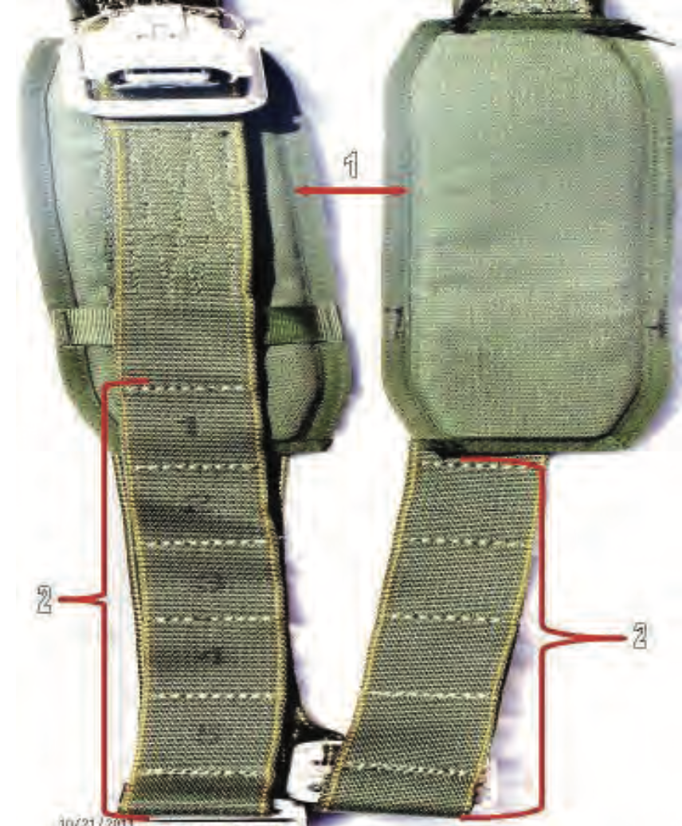
Diagonal Backstrap
Return to Main

Slide 208
Diagonal Backstrap - 1
Return to Main

Slide 209
Diagonal Backstrap Pad
Diagonal Backstrap - 1
Return to Main

Slide 210
Diagonal Backstrap - 2
Return to Main

Slide 211
Sizing Channel
Diagonal Backstrap - 2
Return to Main

Slide 212
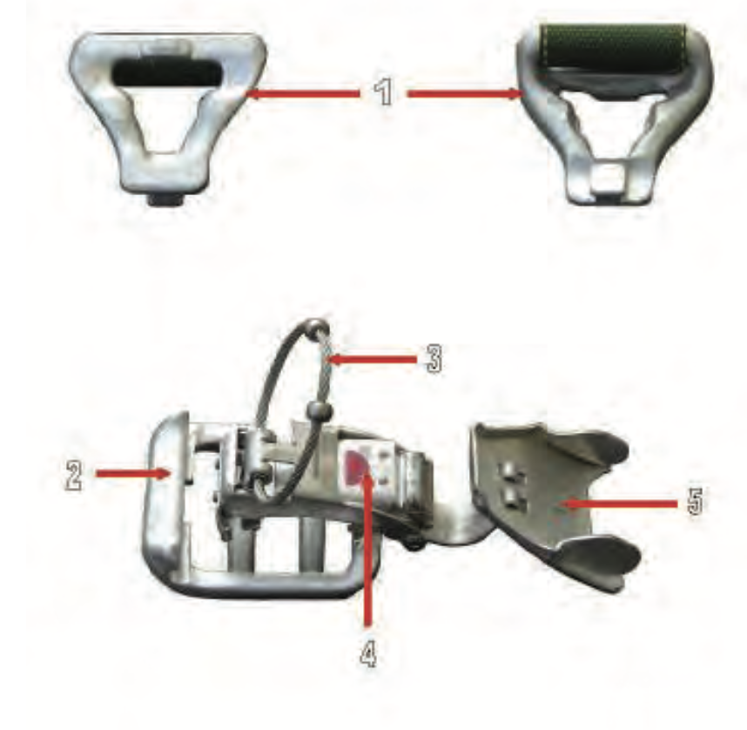
Canopy Release Assembly
Return to Main

Slide 213
Canopy Release Assembly - 1
Return to Main

Slide 214
Male Fitting Canopy Release Assembly
Canopy Release Assembly - 1
Return to Main

Slide 215
Canopy Release Assembly - 2
Return to Main

Slide 216
Female Fitting Canopy Release Assembly
Canopy Release Assembly - 2
Return to Main

Slide 217
Canopy Release Assembly - 3
Return to Main

Slide 218
Cable Loop
Canopy Release Assembly - 3
Return to Main

Slide 219
Canopy Release Assembly - 4
Return to Main

Slide 220
Latch
Canopy Release Assembly - 4
Return to Main

Slide 221
Canopy Release Assembly - 1
Return to Main

Slide 222
Safety Clip
Canopy Release Assembly - 1
Return to Main

Slide 223
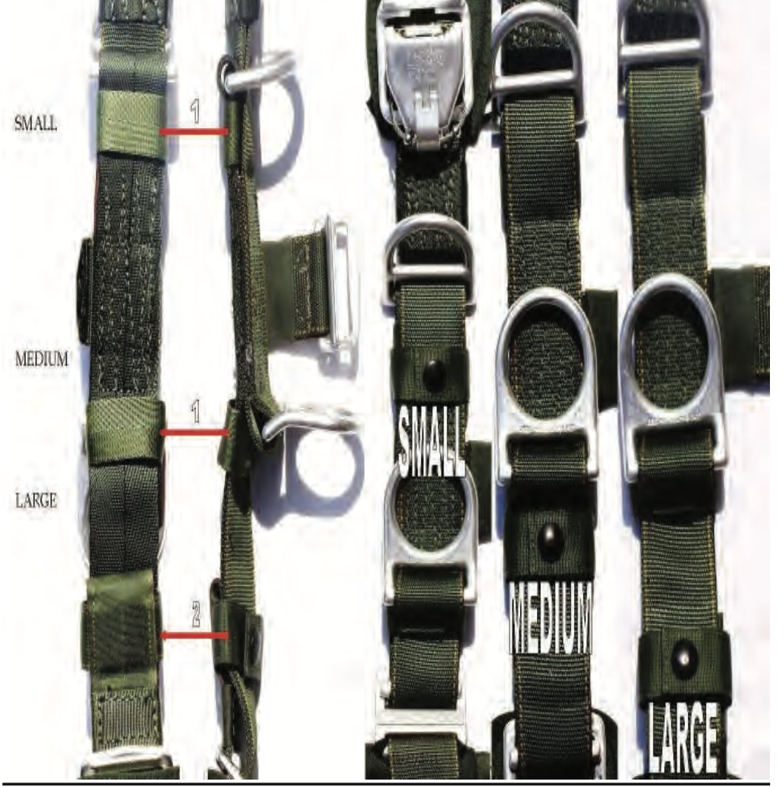
Main Lift Web
Return to Main

Slide 224
Main Lift Web - 1
Return to Main

Slide 225
Tuck Pocket
Main Lift Web - 1
Return to Main

Slide 226
Main Lift Web - 1
Return to Main

Slide 227
Main Lift Web Tuck Tab Assembly
Main Lift Web - 1
Return to Main

Slide 228
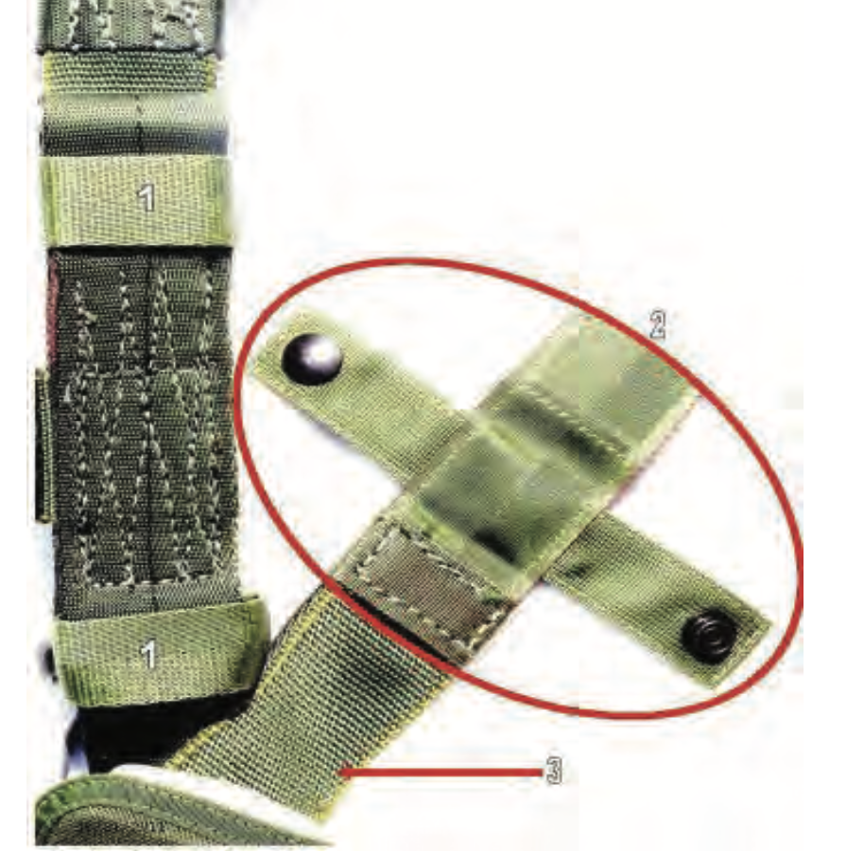
Main Lift Web (Rear)
Return to Main

Slide 229
Main Lift Web (Rear) - 1
Return to Main

Slide 230
Tuck Pocket
Main Lift Web (Rear) - 1
Return to Main

Slide 231
Main Lift Web (Rear) - 1
Return to Main

Slide 232
Main Lift Web Tuck Tab Assembly
Main Lift Web (Rear) - 1
Return to Main

Slide 233
Main Lift Web (Rear) - 1
Return to Main

Slide 234
Main Lift Web Adjustment Strap
Main Lift Web (Rear) - 1
Return to Main

Slide 235
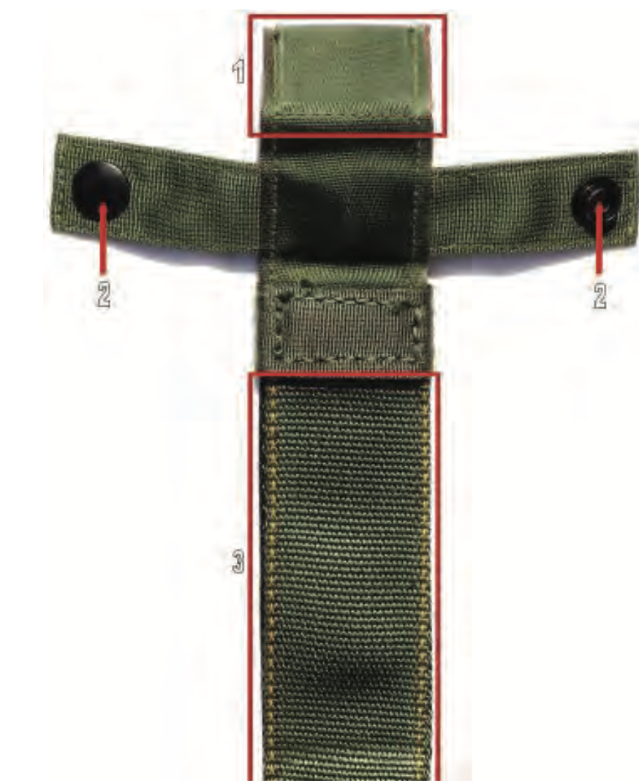
Main Lift Web Tuck Tab Assembly
Return to Main

Slide 236
Main Lift Web Tuck Tab Assembly - 1
Return to Main

Slide 237
Tuck Tab
Main Lift Web Tuck Tab Assembly - 1
Return to Main

Slide 238
Main Lift Web Tuck Tab Assembly - 1
Return to Main

Slide 239
Snap Fastener
Main Lift Web Tuck Tab Assembly - 1
Return to Main

Slide 240
Main Lift Web Tuck Tab Assembly - 1
Return to Main

Slide 241
Main Lift Web Adjustment Strap
Main Lift Web Tuck Tab Assembly - 1
Return to Main

Slide 242
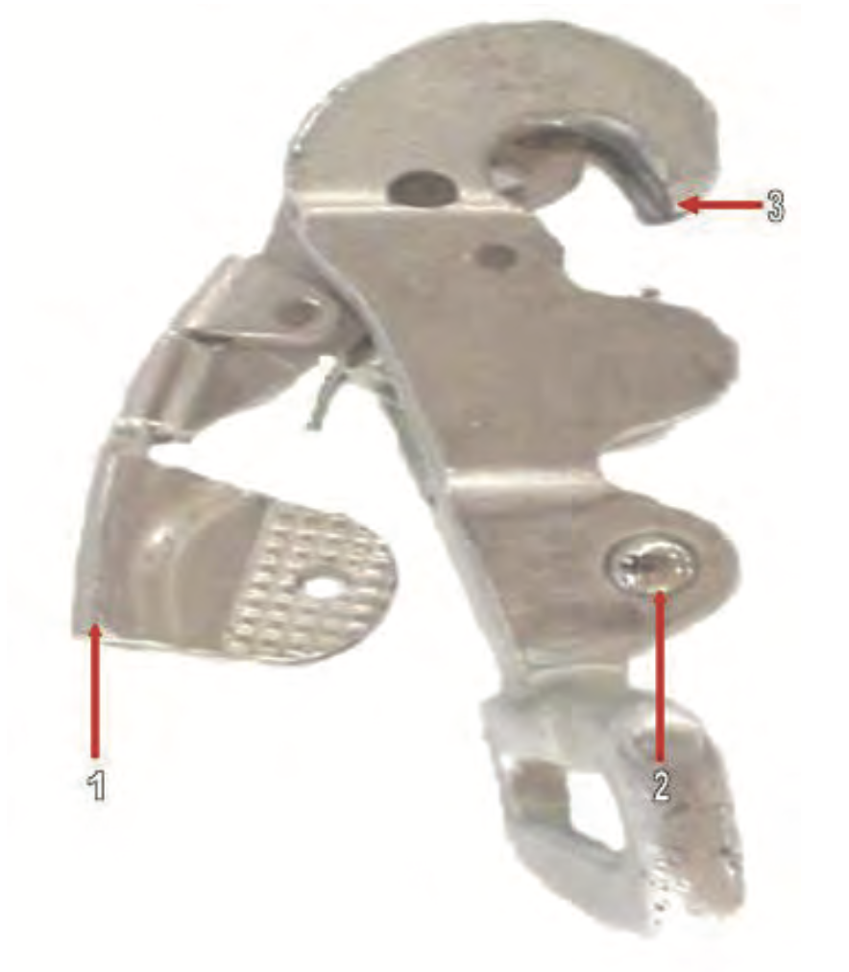
Ejector Snap
Return to Main

Slide 243
Ejector Snap - 1
Return to Main

Slide 244
Activating Lever
Ejector Snap - 1
Return to Main

Slide 245
Ejector Snap - 1
Return to Main

Slide 246
Ball Detent
Ejector Snap - 1
Return to Main

Slide 247
Ejector Snap - 1
Return to Main

Slide 248
Opening Gate
Ejector Snap - 1
Return to Main

Slide 249
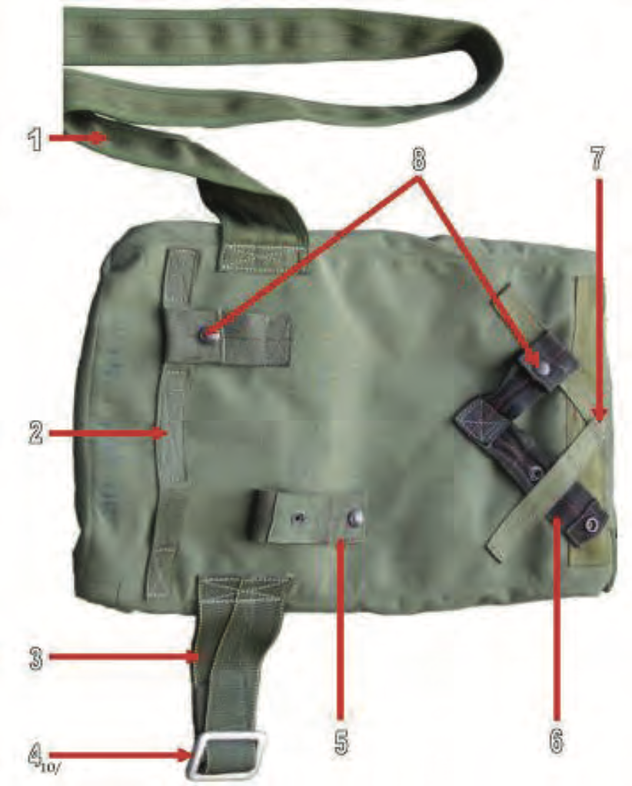
Pack Tray
Return to Main

Slide 250
Pack Tray - 1
Return to Main

Slide 251
Waisteband
Pack Tray - 1
Return to Main

Slide 252
Pack Tray - 2
Return to Main

Slide 253
Horizontal Backstrap Keeper
Pack Tray - 2
Return to Main

Slide 254
Pack Tray - 3
Return to Main

Slide 255
Waistrap Adjuster Panel
Pack Tray - 3
Return to Main

Slide 256
Pack Tray - 4
Return to Main

Slide 257
Metal Adjuster
Pack Tray - 4
Return to Main

Slide 258
Pack Tray - 5
Return to Main

Slide 259
Horizontal Backstrap Retainer
Pack Tray - 5
Return to Main

Slide 260
Pack Tray - 6
Return to Main

Slide 261
Diagonal Backstrap Retainer
Pack Tray - 6
Return to Main

Slide 262
Pack Tray - 7
Return to Main

Slide 263
Diagonal Backstrap Keeper
Pack Tray - 7
Return to Main

Slide 264
Pack Tray - 8
Return to Main

Slide 265
Diagonal Snap Fastener
Pack Tray - 8
Return to Main

Slide 266
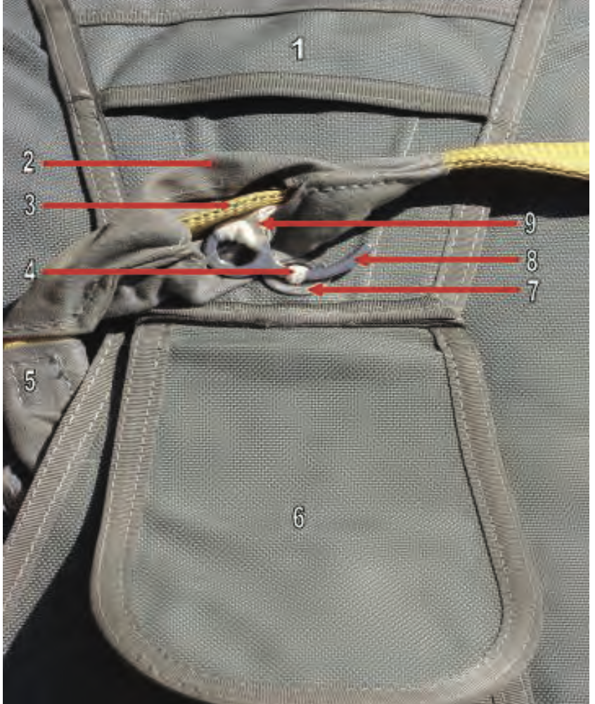
Pack Tray (Zoom)
Continued
Return to Main

Slide 267
Pack Tray (Zoom) - 1
Return to Main

Slide 268
Tuck Flap
Pack Tray (Zoom) - 1
Return to Main

Slide 269
Pack Tray (Zoom) - 2
Return to Main

Slide 270
Main Curved Pin Cover
Pack Tray (Zoom) - 2
Return to Main

Slide 271
Pack Tray (Zoom) - 3
Return to Main

Slide 272
Universal Static Line
Pack Tray (Zoom) - 3
Return to Main

Slide 273
Pack Tray (Zoom) - 4
Return to Main

Slide 274
Main Closing Loop
Pack Tray (Zoom) - 4
Return to Main

Slide 275
Pack Tray (Zoom) - 5
Return to Main

Slide 276
Static Line Sleeve
Pack Tray (Zoom) - 5
Return to Main

Slide 277
Pack Tray (Zoom) - 6
Return to Main

Slide 278
Main Curved Pin Protector Flap
Pack Tray (Zoom) - 6
Return to Main

Slide 279
Pack Tray (Zoom) - 7
Return to Main

Slide 280
Grommet
Pack Tray (Zoom) - 7
Return to Main

Slide 281
Pack Tray (Zoom) - 8
Return to Main

Slide 282
Main Curved Pin
Pack Tray (Zoom) - 8
Return to Main

Slide 283
Pack Tray (Zoom) - 9
Return to Main

Slide 284
Main Curved Pin Attaching Loop
Pack Tray (Zoom) - 9
Return to Main

Slide 285
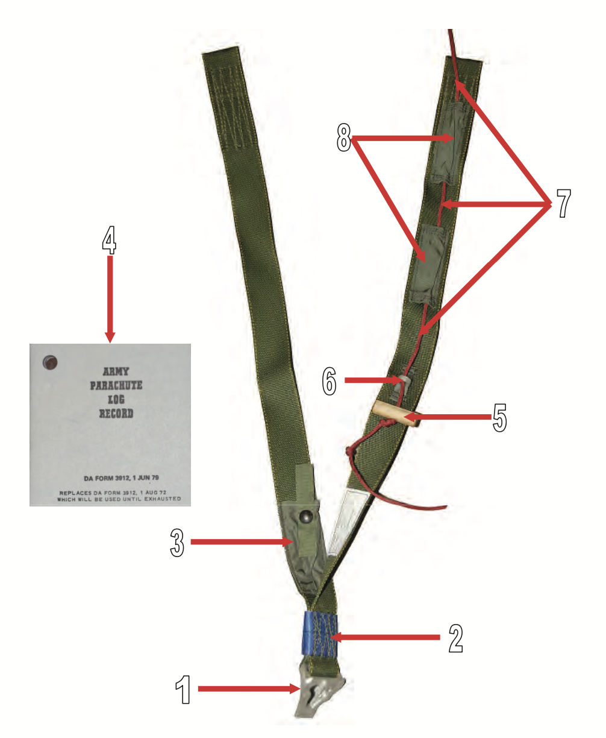
MC-6 Riser Assembly
Return to Main

Slide 286
MC-6 Riser Assembly - 1
Return to Main

Slide 287
Male Fitting Canopy Release Assembly
MC-6 Riser Assembly - 1
Return to Main

Slide 288
MC-6 Riser Assembly - 2
Return to Main

Slide 289
Blue Confluence Wrap
MC-6 Riser Assembly - 2
Return to Main

Slide 290
MC-6 Riser Assembly - 3
Return to Main

Slide 291
Army Parachute Log Record Stow Pouch
MC-6 Riser Assembly - 3
Return to Main

Slide 292
MC-6 Riser Assembly - 4
Return to Main

Slide 293
Army Parachute Log Record
MC-6 Riser Assembly - 4
Return to Main

Slide 294
MC-6 Riser Assembly - 5
Return to Main

Slide 295
Toggle Knob
MC-6 Riser Assembly - 5
Return to Main

Slide 296
MC-6 Riser Assembly - 6
Return to Main

Slide 297
Control Line Guide Ring
MC-6 Riser Assembly - 6
Return to Main

Slide 298
MC-6 Riser Assembly - 7
Return to Main

Slide 299
Control Line
MC-6 Riser Assembly - 7
Return to Main

Slide 300
MC-6 Riser Assembly - 8
Return to Main

Slide 301
Control Line Channel
MC-6 Riser Assembly - 8
Return to Main

Slide 302
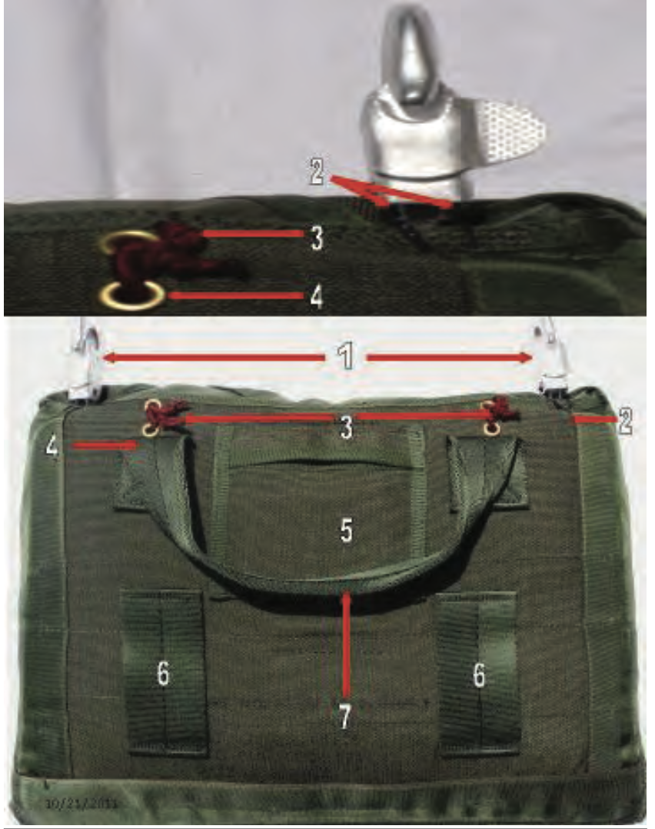
Reserve Pack Tray (Back)
Back
Return to Main

Slide 303
Reserve Pack Tray (Back) - 1
Return to Main

Slide 304
Connector Snap
Reserve Pack Tray (Back) - 1
Return to Main

Slide 305
Reserve Pack Tray (Back) - 2
Return to Main

Slide 306
Connector Snap Retaining Tie
Reserve Pack Tray (Back) - 2
Return to Main

Slide 307
Reserve Pack Tray (Back) - 3
Return to Main

Slide 308
Spreader Bar Ties (Must be Red)
Reserve Pack Tray (Back) - 3
Return to Main

Slide 309
Reserve Pack Tray (Back) - 4
Return to Main

Slide 310
Grommet
Reserve Pack Tray (Back) - 4
Return to Main

Slide 311
Reserve Pack Tray (Back) - 5
Return to Main

Slide 312
Army Parachute Log Record Stow Pocket
Reserve Pack Tray (Back) - 5
Return to Main

Slide 313
Reserve Pack Tray (Back) - 6
Return to Main

Slide 314
Waistband Retainer
Reserve Pack Tray (Back) - 6
Return to Main

Slide 315
Reserve Pack Tray (Back) - 7
Return to Main

Slide 316
Carrying Handle
Reserve Pack Tray (Back) - 7
Return to Main

Slide 317
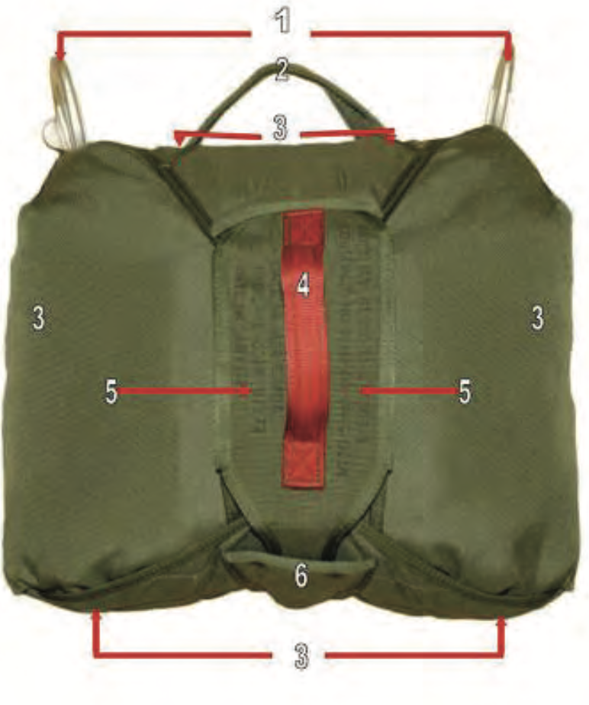
Reserve Pack Tray
Front
Return to Main

Slide 318
Reserve Pack Tray (front)- 1
Return to Main

Slide 319
Connector Snap
Reserve Pack Tray (front)- 1
Return to Main

Slide 320
Reserve Pack Tray (front)- 2
Return to Main

Slide 321
Carrying Handle
Reserve Pack Tray (front)- 2
Return to Main

Slide 322
Reserve Pack Tray (front) - 3
Return to Main

Slide 323
Pack Closing Flap
Reserve Pack Tray (front) - 3
Return to Main

Slide 324
Reserve Pack Tray (front) - 4
Return to Main

Slide 325
Rip Cord Handle
Reserve Pack Tray (front) - 4
Return to Main

Slide 326
Reserve Pack Tray (front) - 5
Return to Main

Slide 327
Rip Cord Assembly
Reserve Pack Tray (front) - 5
Return to Main

Slide 328
Reserve Pack Tray (front) - 6
Return to Main

Slide 329
Tuck Pocket
Reserve Pack Tray (front) - 6
Return to Main

Slide 330
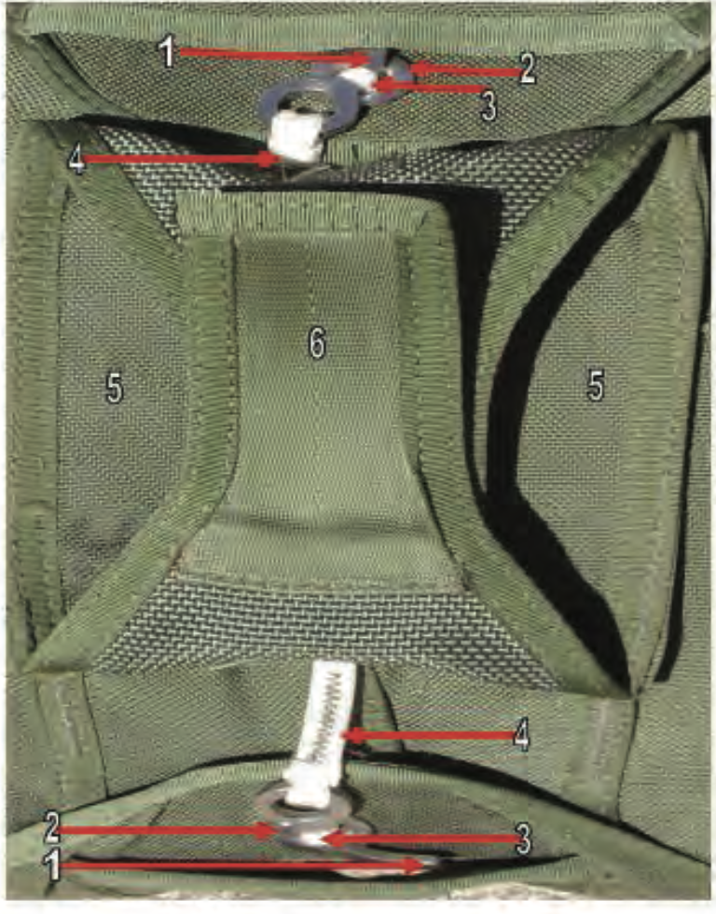
Reserve Pack Tray (opened)
Front-2
Return to Main

Slide 331
Reserve Pack Tray (opened) - 1

Slide 332
Curved Pin
Reserve Pack Tray (opened) - 1

Slide 333
Reserve Pack Tray (opened) - 2

Slide 334
Grommet
Reserve Pack Tray (opened) - 2

Slide 335
Reserve Pack Tray (opened) - 3

Slide 336
Reserve Closing Loop
Reserve Pack Tray (opened) - 3

Slide 337
Reserve Pack Tray (opened) - 4

Slide 338
Curved Pin Lanyard
Reserve Pack Tray (opened) - 4

Slide 339
Reserve Pack Tray (opened) - 5

Slide 340
Rip Cord Assembly
Reserve Pack Tray (opened) - 5

Slide 341
Reserve Pack Tray (opened) - 6

Slide 342
Bottom Tuck Tab
Reserve Pack Tray (opened) - 6

Slide 343
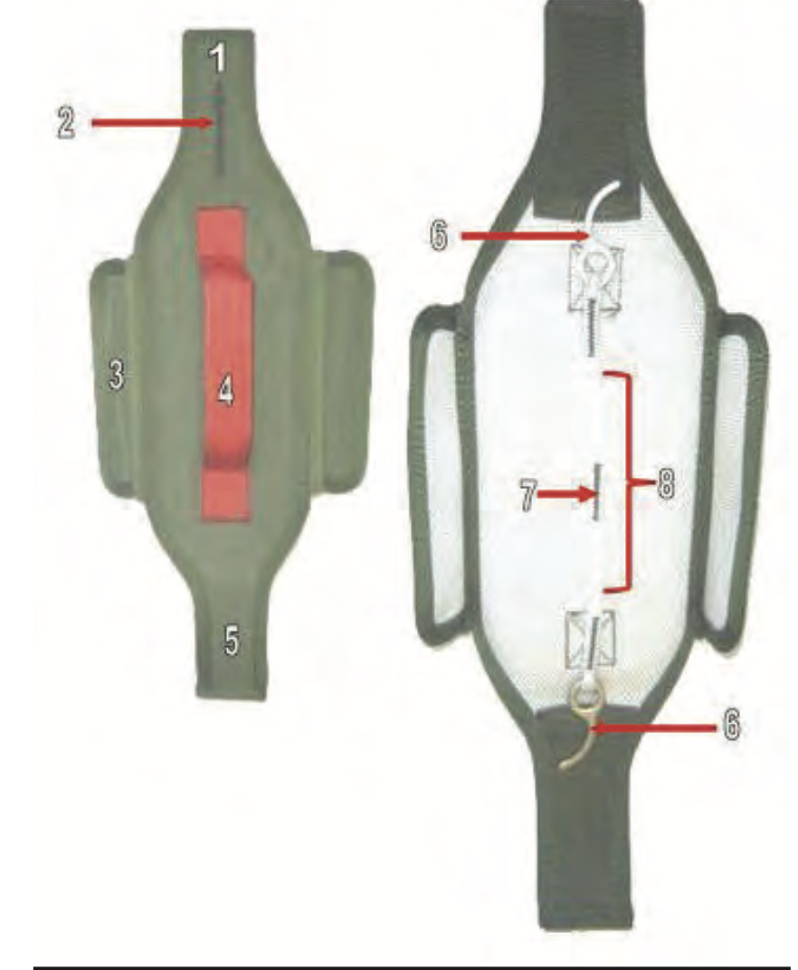
Rip Cord Assembly
Return to Main

Slide 344
Rip Cord Assembly - 1
Return to Main

Slide 345
Top Tuck Tab
Rip Cord Assembly - 1
Return to Main

Slide 346
Rip Cord Assembly - 2
Return to Main

Slide 347
Directional Arrow
Rip Cord Assembly - 2
Return to Main

Slide 348
Rip Cord Assembly - 3
Return to Main

Slide 349
Side Tuck Tabs
Rip Cord Assembly - 3
Return to Main

Slide 350
Rip Cord Assembly - 4
Return to Main

Slide 351
Rip Cord Handle
Rip Cord Assembly - 4
Return to Main

Slide 352
Rip Cord Assembly - 5
Return to Main

Slide 353
Bottom Tuck Tab
Rip Cord Assembly - 5
Return to Main

Slide 354
Rip Cord Assembly - 6
Return to Main

Slide 355
Curved Pin
Rip Cord Assembly - 6
Return to Main

Slide 356
Rip Cord Assembly - 7
Return to Main

Slide 357
Reinforced Stitching
Rip Cord Assembly - 7
Return to Main

Slide 358
Rip Cord Assembly - 8
Return to Main

Slide 359
Curved Pin Lanyard
Rip Cord Assembly - 8
Return to Main

