Slide 1
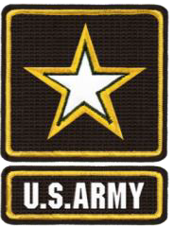
DA Form 2166-9 Series
Module 3: NCOER Support Form & Grade Plate NCOERs
as of 10 July 2015

Slide 2
Agenda
What is Changing on the NCOER
NCOER Support Form
Grade Plate NCOER
− Part I – ADMINISTRATIVE DATA
− Part II – AUTHENTICATION
− Part III – DUTY DESCRIPTION
− Parts IVa and IVb – APFT and HT / WT
Army Leadership
Performance Measures
− “FAR EXCEEDED STANDARD”
− “EXCEEDED STANDARD”
− “MET STANDARD”
− “DID NOT MEET STANDARD”

Slide 3
Agenda (cont.)
Part IV – Rater Assessment
− CHARACTER
− Direct-level Report (SGT)
− Organizational-level Report (SSG-1SG/MSG)
− Strategic-level Report (CSM/SGM)
Potential Measures
− “MOST QUALIFIED”
− “HIGHLY QUALIFIED”
− “QUALIFIED”
− “NOT QUALIFIED”
Part V – Senior Rater Assessment
− Direct-level Report (SGT)
− Organizational- and Strategic-level Reports (SSG through CSM/SGM)

Slide 4
What is Changing on the NCOER
CHARACTERISTIC | CURRENT NCOER (DA FORM 2166-8) | NEW NCOER (DA FORM 2166-9 SERIES)
NCOER Support Form | Based on the Leadership Dimensions of FM 22-100 Rater counsels initially and quarterly Senior rater – no requirement to counsel Reviewer – no requirement to counsel; provides oversight/assists rating chain | Aligns with Leadership Requirements Model of ADP 6-22 Rated NCO provides goals and expectations Rater counsels initially and quarterly Senior rater should counsel twice during rating period Supplementary reviewer, as required Incorporates SSD/NCOES completion box for next grade
Form | One report for all NCOs | Three reports SGT (Direct) SSG through 1SG/MSG (Organizational) CSM/SGM (Strategic)
Rating Chain Responsibilities | Rater assesses performance and potential Senior rater assesses performance and potential Reviewer provides oversight/assists rating chain | Rater assesses performance Senior rater assesses potential Supplementary reviewer, as required
Army Leadership Doctrine | Based on Leadership Dimensions of FM 22-100 | Aligns with Leadership Requirements Model of ADP 6-22
Assessment Format | Bullet comments for all NCOs | Rater Bullet comments for SGT through 1SG/MSG Narrative comments for CSM/SGM Senior rater – narrative comments for all NCOs
Senior Rater Assessment | Uncontrolled promotion-based “1” – Recommendation for immediate promotion “2” – Strong recommendation for promotion “3” – Recommendation for promotion “4” – Should not be promoted at this time “5” – Do not promote | Controlled potential-based “MOST QUALIFIED” (limited to 24%) “HIGHLY QUALIFIED” “QUALIFIED” “NOT QUALIFIED”
Rating Chain Accountability | No accountability | Rater tendency and constrained senior rater profile for SSG through CSM/SGM

Slide 5
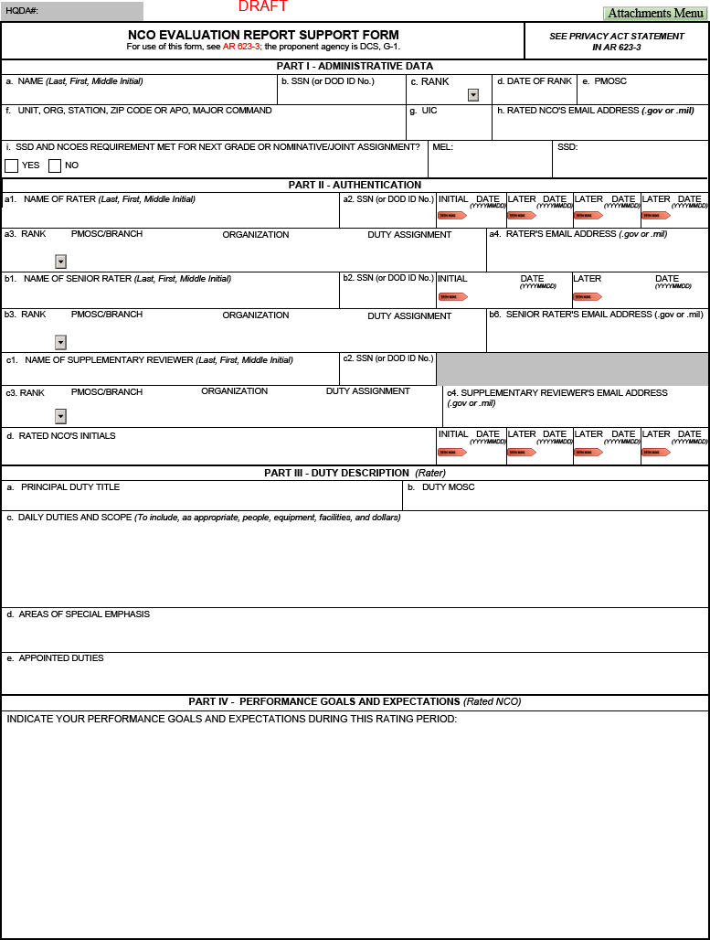
NCOER Support Form – Page 1
Part I – SSD and NCOES requirement met for next grade
Part II – Senior rater should counsel the rated NCO, at a minimum, twice during rating period
Part II, block c – Supplementary reviewer, as required
Up to 7 lines of text
Part IV – Rated NCO provides goals and expectations
Up to 2 lines of text
Up to 2 lines of text
Up to 16 lines of text

Slide 6
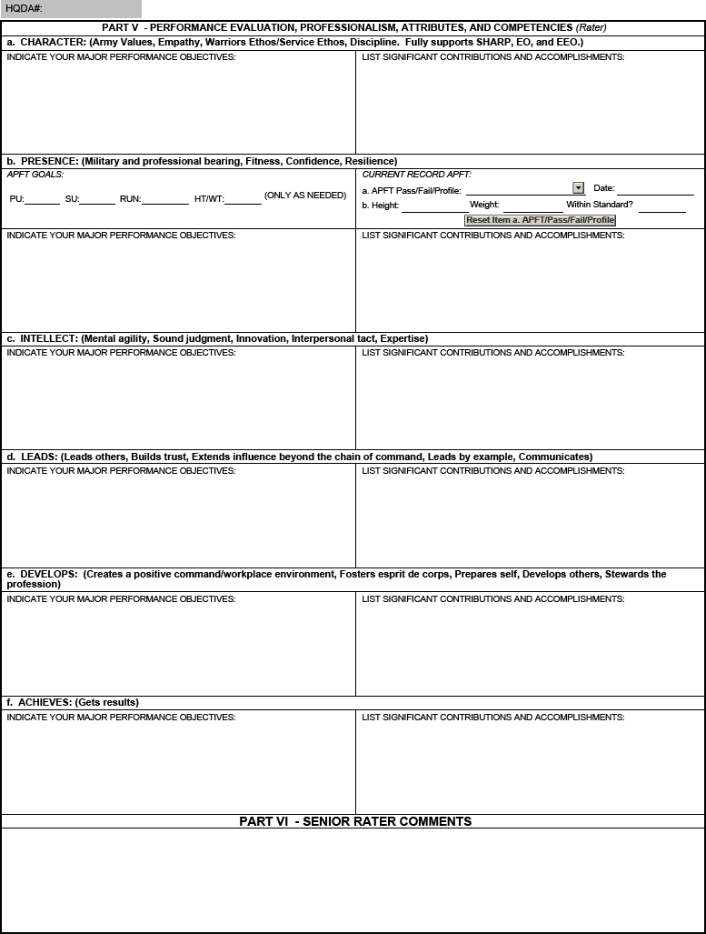
NCOER Support Form – Page 2
Part V – Attributes and Competencies (ADP 6-22)
Part VI – Senior rater provides comments.
Up to 8 lines of text for each field

Slide 7
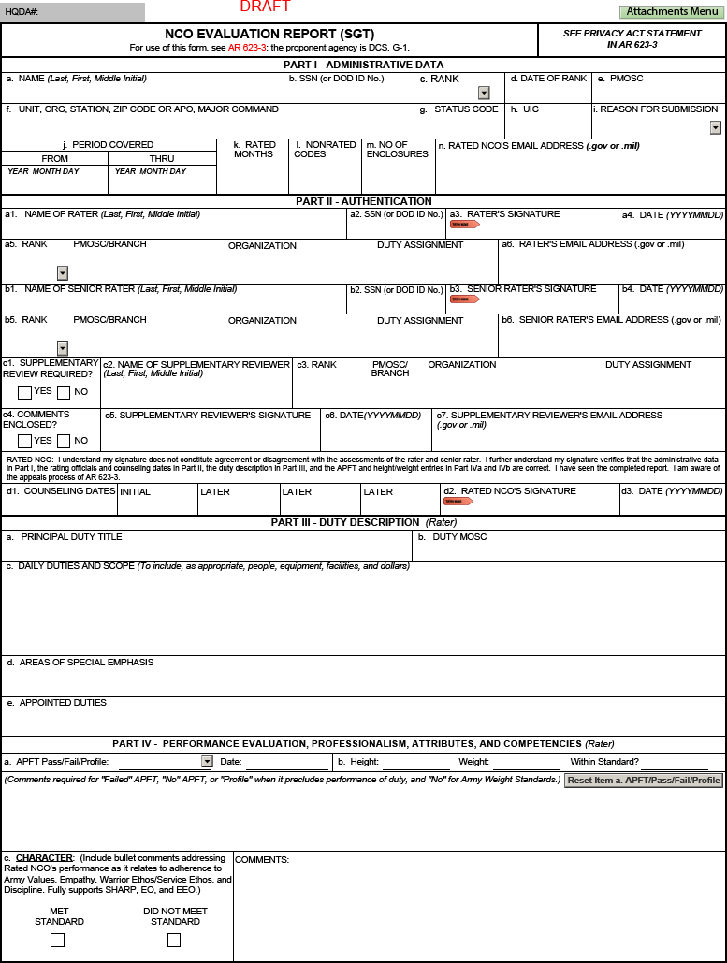
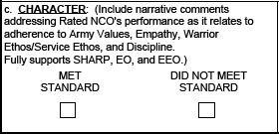
Grade Plate NCOER – Page 1
Front page – same for all grade-plate forms
Part II, block c – Supplementary reviewer, as required
Part IV, blocks a and b – APFT
and HT/WT
Up to 7 lines of text
Up to 5 lines of text
Bullet comments for all grade plates
except Strategic Report (CSM/SGM)

Slide 8
Part I – Administrative Data
DOD ID Number will be the primary number utilized; SSN should only be used if DOD ID Number is not available
Must ensure the Unit Identification Code (UIC) is entered correctly to retrieve data in the Evaluation Reporting System (ERS)

Slide 9
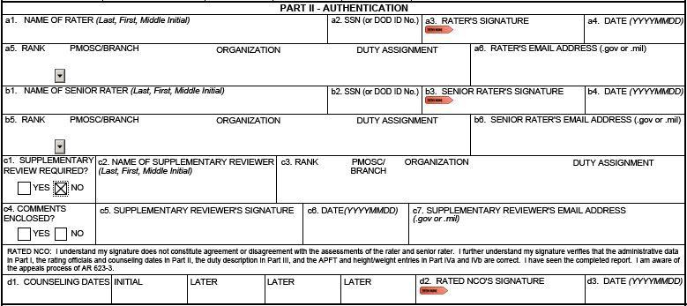
Part II – Authentication
DOD ID Number will be the primary number utilized; SSN should only be used if DOD ID Number is not available
Use Enterprise email address
If a supplementary review is not required, then the user will select “NO” in Part II, block c1 and leave the remaining section blank
Rated NCO’s signature will verify the accuracy of administrative data in Part I, the rating officials and counseling dates in Part II, the duty description in Part III, and the APFT and HT/WT entries in Part IV

Slide 10
Part III – Duty Description
Up to 7 lines of text
Up to 2 lines of text
Up to 2 lines of text
Rater will annotate the following:
Principal duty title
Duty MOSC
Daily duties and scope
Areas of special emphasis
Appointed duties

Slide 11
Part IVa and IVb – APFT and HT / WT
Up to 5 lines of text
Rater will enter the following:
APFT
− PASS
− FAIL
− PROFILE
− PREGNANT POST PARTUM
− NO APFT
HT / WT (including compliance with AR 600-9)

Slide 12
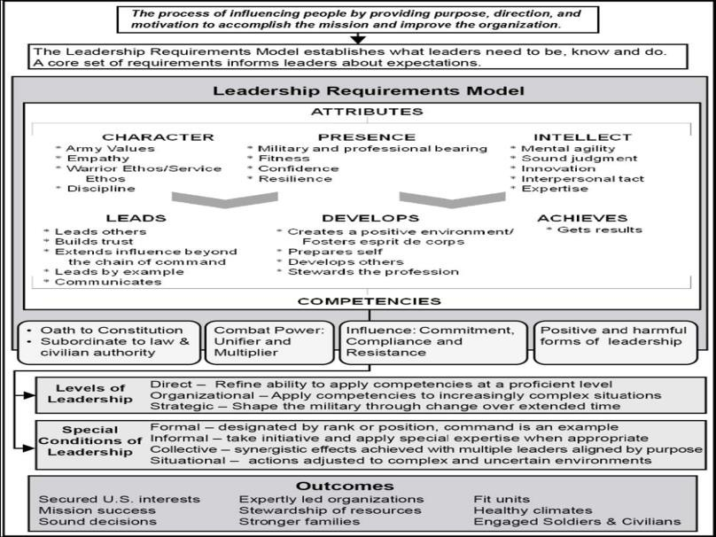
Army Leadership

Slide 13
Attributes – What a Leader Is
Level | CHARACTER (Army Values, Empathy, Warrior Ethos / Service Ethos, Discipline, SHARP/EO/EEO) | PRESENCE (Military and professional bearing, Fitness, Confidence, Resilience) | INTELLECT (Mental agility, Sound judgment, Innovation, Interpersonal tact, Expertise)
Direct (SGT) | Creates a climate that embraces Army Values; character is aligned with the Army’s expectations | Demonstrates good presence and confidence across expected duties of the position. | Conceptual capabilities, interpersonal tact, and domain knowledge are effective for direct level
Organizational (SSG – 1SG / MSG) | Exhibits behaviors that are clear outward expression that aligns personal character with Army expectations | Demonstrates excellent presence, confidence and resilience in expected duties and unexpected situations. | Conceptual capabilities, interpersonal tact, and domain knowledge are effective for operations at battalion and below
Strategic (CSM / SGM) | Demonstrates a sense of responsibility for the Army profession; character is of absolute integrity | Astutely manages complexity and anticipates transitions at strategic level; viewed as champions of causes, diplomats and ambassadors of high level interests. | Excels at complex thinking and multiple perspectives; adept with the Army design method; broad and deep understanding of history, world situations, technological possibilities, and dynamics of organizations.
*Based on Leader Development Strategy for a 21st Century Army, 25 Nov 09

Slide 14
Competencies – What a Leader Does
Level | LEADS (Leads others, Builds trust, Extends influence beyond the chain of command, Leads by example, Communicates) | DEVELOPS (Creates a positive command / workplace environment, Fosters esprit de corps, Prepares self, Develops others, Stewards the profession) | ACHIEVES (Gets results)
Direct (SGT) | Demonstrated troop leading procedures and employment of TTPs relevant to their unit. | Builds environment of teams and teamwork. | Directs and prioritizes tasks for Squad level and below.
Organizational (SSG – 1SG / MSG) | Demonstrated competence in resolving complex situations. | Proactive in developing others through individual coach, teach and mentor subordinates; accurately and fairly assess, identifies future leaders. | Demonstrates ability to lead through complexity and time, decentralized operations and ill-structured problems. Prioritizes limited resources to accomplish mission.
Strategic (CSM / SGM) | Sets vision for operational and strategic level operations. | Creates systems and adopts policies supporting professional and personal growth across the organization. Stewards the Army’s interest in caring for and managing people and other resources. | Demonstrates ability to develop and describe broad vision and framework. Organizes, resources, integrates and aligns efforts among organizations to achieve mission goals.
*Based on Leader Development Strategy for a 21st Century Army, 25 Nov 09

Slide 15
Performance Measures
Organizational- and Strategic-level (SSG through CSM/SGM)
Direct-level (SGT)
FAR EXCEEDED STANDARD | EXCEEDED STANDARD | MET STANDARD | DID NOT MEET STANDARD
Rated NCO performs extraordinarily above the required Army standards and organizational goals of leader competencies and attributes; leadership enables Soldiers and unit to far surpass required organizational and Army standards; demonstrated performance epitomizes excellence in all aspects; this NCO and his/her Soldiers consistently take disciplined initiative in applying leader competencies and attributes; results have an immediate impact and enduring effect on the mission, their Soldiers, the unit, and the Army; demonstrated by the best of the upper third of NCOs of the same grade. | Rated NCO performs above the required Army standards and organizational goals of leader competencies and attributes; this NCO and his/her Soldiers often take disciplined initiative in applying leader competencies and attributes; results have an immediate impact on the mission, their Soldiers, the unit, and the Army; this level of performance is not common, typically demonstrated by the upper third of NCOs of the same grade. | Rated NCO successfully achieves and maintains the required Army standards and organizational goals of leader competencies and attributes; effectively meets and enforces the standard for the unit and those in his/her charge; succeeds by taking appropriate initiative in applying the leader competencies and attributes; results have a positive impact on the mission, their Soldiers, the unit, and the Army; this level of performance is considered normal and typically demonstrated by a majority of NCOs of the same grade. | Rated NCO fails to meet or maintain the required Army standards and organizational goals of leader competencies and attributes; does not enforce or meet the standard for the unit or those in his/her charge; exhibits/displays minimal or no effort; actions often have a negative effect on the mission, their Soldiers, the unit, and the Army.

Slide 16
FAR EXCEEDED STANDARD
(applies to Organizational- and Strategic-level NCOERs
FAR EXCEEDED STANDARD
Rated NCO performs extraordinarily above the required Army standards and organizational goals of leader competencies and attributes; leadership enables Soldiers and unit to far surpass required organizational and Army standards; demonstrated performance epitomizes excellence in all aspects; this NCO and his/her Soldiers consistently take disciplined initiative in applying leader competencies and attributes; results have an immediate impact and enduring effect on the mission, their Soldiers, the unit, and the Army; demonstrated by the best of the upper third of NCOs of the same grade.
o placed 1st of 23 teams in the recent LTG David E.
Grange Jr. Best Ranger Competition
o nominated and selected over 11 senior NCOs to serve as the Army Corrections Command Operations Sergeant
o selected as the Secretary of the Army Career Counselor of the Year; incomparable retention knowledge
o expertly led his/her SGLs to earn an Institute of Excellence rating within eight months of arrival
o selected by Corps/Division G-1 as the best Brigade S-1 within area of responsibility

Slide 17
EXCEEDED STANDARD
(applies to Organizational- and Strategic-level NCOERs)
EXCEEDED STANDARD
Rated NCO performs above the required Army standards and organizational goals of leader competencies and attributes; this NCO and his/her Soldiers often take disciplined initiative in applying leader competencies and attributes; results have an immediate impact on the mission, their Soldiers, the unit, and the Army; this level of performance is not common, typically demonstrated by the upper third of NCOs of the same grade.
o mentored two squad members to be inducted into the
Sergeant Audie Murphy Club
o graduated from M1A2/MGS/Bradley Master Gunner’s Course
o scored 2+/2+ on the Defense Language Proficiency Test
(DLPT); surpassed Army standard in a Category IV language
o recognized with the Military Outstanding Volunteer Service Medal for volunteering over 100 hours with local community
o selected over eight seniors and 15 peers by the Deputy Commanding General to serve as Master Driver

Slide 18
MET STANDARD
(applies to all Grade Plate NCOERs)
MET STANDARD
Rated NCO successfully achieves and maintains the required Army standards and organizational goals of leader competencies and attributes; effectively meets and enforces the standard for the unit and those in his/her charge; succeeds by taking appropriate initiative in applying the leader competencies and attributes; results have a positive impact on the mission, their Soldiers, the unit, and the Army; this level of performance is considered normal and typically demonstrated by a majority of NCOs of the same grade.
o established a workplace environment and overall command
climate that fostered dignity and respect for all team members
o scored 263 on last APFT helping company to achieve a 250 average
o assisted in the weapons qualification of 200 Soldiers throughout the battalion
o developed a strong priority work plan and anticipated constant change; successfully completed all missions
o developed several SOPs that were effectively used by Soldiers for accomplishment of daily missions

Slide 19
DID NOT MEET STANDARD
(applies to all Grade Plate NCOERs)
DID NOT MEET STANDARD
Rated NCO fails to meet or maintain the required Army standards and organizational goals of leader competencies and attributes; does not enforce or meet the standard for the unit or those in his/her charge; exhibits/displays minimal or no effort; actions often have a negative effect on the mission, their Soldiers, the unit, and the Army.
o failed to consistently adhere to rules, regulations, or standard operating procedures
o demonstrated no concern for security and accountability of sensitive items
o displayed meager enthusiasm and optimism; his/her actions discouraged others to develop and reach their full potential
o failed to maintain accountability of Soldiers under his supervision; fabricated status reports
o declined to address subordinate’s request for assistance with personal issues

Slide 20
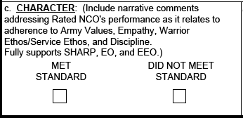
Part IV – CHARACTER
Up to 8 lines of text for each field in Part IV, blocks c through h (ex. Three two-line bullets with a one-line space between them.
Raters must assess the rated NCO’s performance in fostering a climate of dignity and respect and adhering to the requirements of the SHARP Program
Narrative comments will be entered for Part IV, block c on DA Form 2166-9-3 (CSM/SGM)

Slide 21
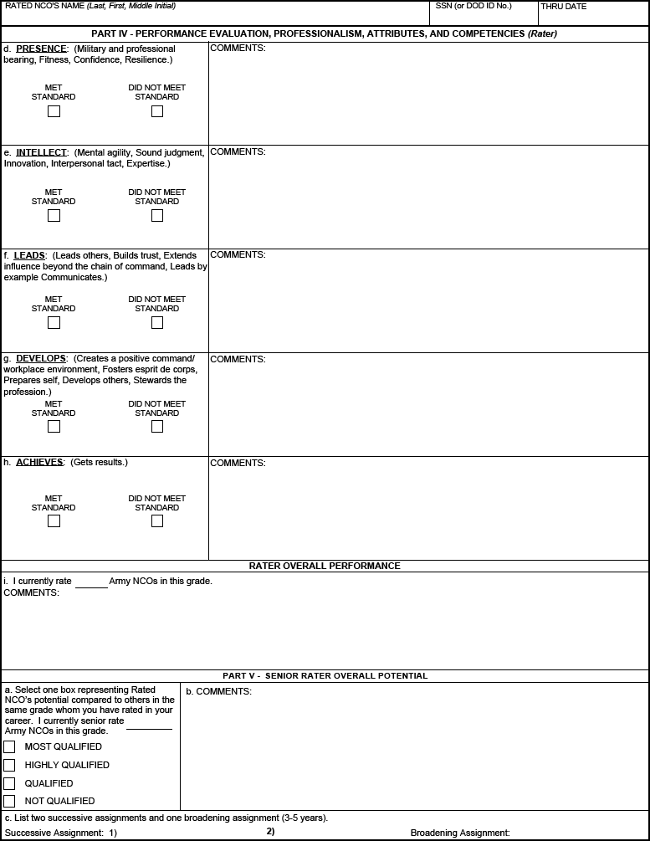
Part IV – Rater Assessment (SGT)
Rater assesses performance using a 2-box scale; focused on technical proficiency and is developmental in nature
‒ “MET STANDARD”
‒ “DID NOT MEET STANDARD”
Up to 8 lines of text (bullet format) for each field in Part IV, blocks c through h
Rater – bullet comment format
Up to 5 lines of text (bullet format)

Slide 22
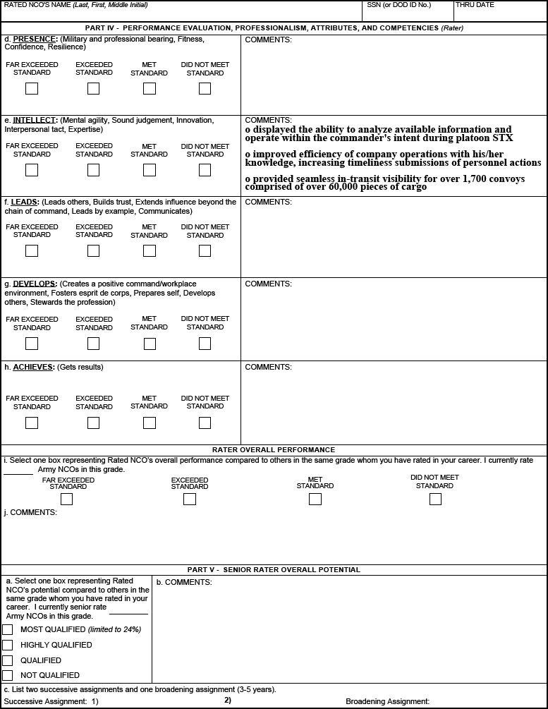
Part IV – Rater Assessment (SSG-1SG/MSG)
Rater assesses performance using a 4-box scale; focused on organizational systems and processes
− “FAR EXCEEDED STANDARD”
− “EXCEEDED STANDARD”
− “MET STANDARD”
− “DID NOT MEET STANDARD”
Up to 8 lines of text (bullet format) for each field in Part IV, blocks c through h
Rater – bullet comment format
Unconstrained rater overall performance assessment
Up to 5 lines of text (bullet format)

Slide 23
Part IV – Rater Assessment (CSM/SGM)
Performance assessment focused on large organizations and strategic initiatives
Narrative must address each attribute and competency
Unconstrained rater overall performance assessment
Up to 5 lines of text (narrative format)
Up to 4 lines of text (narrative format)

Slide 24
Potential Measures
Limited to 24%
“MOST QUALIFIED” – identify NCOs with strong potential for promotion in the secondary zone; ahead of peers (Note: Senior raters will manage a constrained profile up to 24% for the top block or “MOST QUALIFIED”.)
“HIGHLY QUALIFIED” – identify NCOs with strong potential for promotion with peers
“QUALIFIED” – identify NCOs who demonstrate potential to be successful
at the next level; promote if able
“NOT QUALIFIED” – identify NCOs who do not demonstrate potential for promotion; recommend separation

Slide 25
Part V – Senior Rater Assessment (SGT)
Up to 5 lines of text (narrative format)
Duty title only
Duty title only
Duty title only
Senior rater assessment of rated NCO’s overall potential
compared to NCOs in same grade
Unconstrained box check
Narrative comment format

Slide 26
Part V – Senior Rater Assessment (SSG-CSM/SGM)
Up to 5 lines of text (narrative format)
Duty title only
Duty title only
Duty title only
Senior rater assessment of rated NCO’s overall potential
compared to NCOs in same grade
Constrained senior rater profile; limited to 24% of total
reports
Only one of the first four NCOERs may be rated as “MOST QUALIFIED” (“Silver bullet”)
Narrative comment format

Slide 27
Summary
What is Changing on the NCOER
NCOER Support Form
Grade Plate NCOER
− Part I – ADMINISTRATIVE DATA
− Part II – AUTHENTICATION
− Part III – DUTY DESCRIPTION
− Parts IVa and IVb – APFT and HT / WT
Army Leadership
Performance Measures
− “FAR EXCEEDED STANDARD”
− “EXCEEDED STANDARD”
− “MET STANDARD”
− “DID NOT MEET STANDARD”

Slide 28
Summary (cont.)
Part IV – Rater Assessment
− CHARACTER
− Direct-level Report (SGT)
− Organizational-level Report (SSG-1SG/MSG)
− Strategic-level Report (CSM/SGM)
Potential Measures
− “MOST QUALIFIED”
− “HIGHLY QUALIFIED”
− “QUALIFIED”
− “NOT QUALIFIED”
Part V – Senior Rater Assessment
− Direct-level Report (SGT)
− Organizational- and Strategic-level Reports (SSG through CSM/SGM)

Slide 29
Questions

